Slide 1
Unix Tutorial
Lijing Bu
Daniel Felker
UNM Bioinformatics Club
07/17/2013

Slide 2
Outlines
Unix server
Computing power and storage capacity
SSH & putty, IP address : 129.24.145.230
Practice with commands
ls, man, head, tail, less, more, grep, sort, uniq, zcat, zgrep, cut, mkdir, mv, rm, top, scp, sed, awk
Practice of calling other programs
Use program ABySS 1.3.5 to assembly E. coli short reads
Demo of Perl Script
Automatic workflows
NGS Tools
http://seqanswers.com/forums/showthread.php?t=43

Slide 3
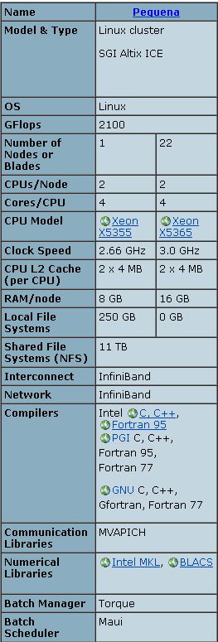
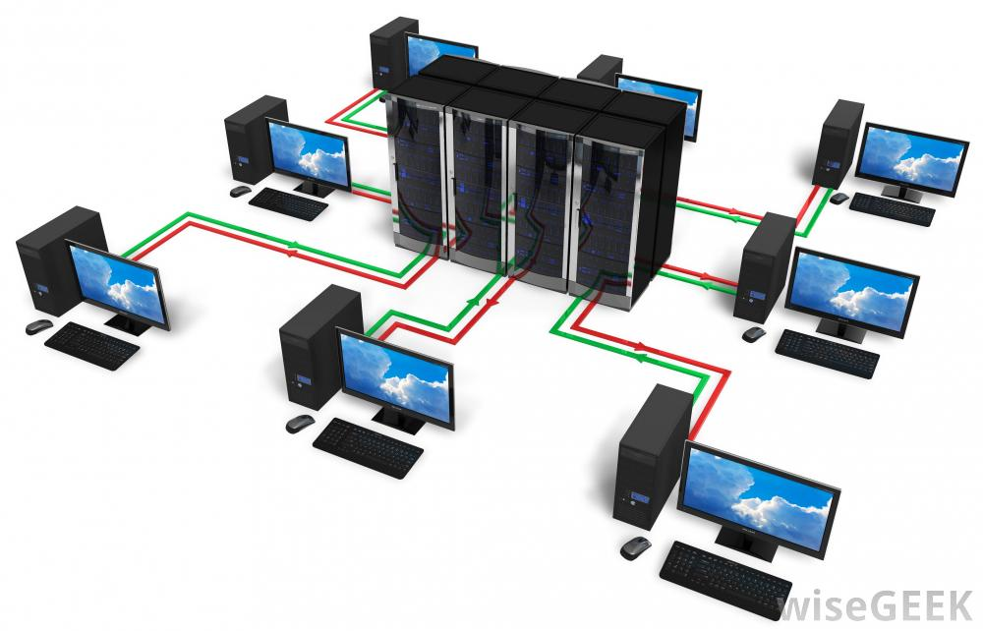
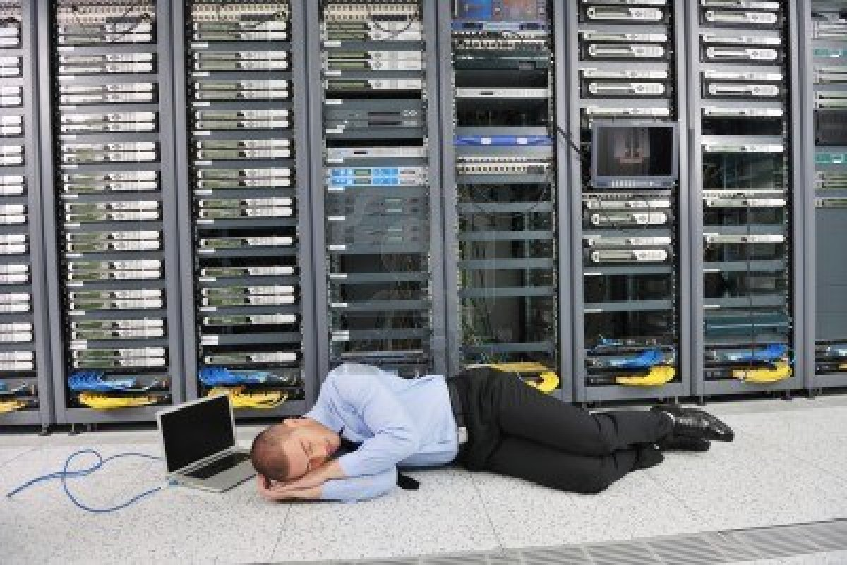
We need the server
Configuration example of one machine from the
UNM Center for Advanced Research Computing
http://www.hpc.unm.edu/systems-table
This is one of things you could do after type in the command.

Slide 4
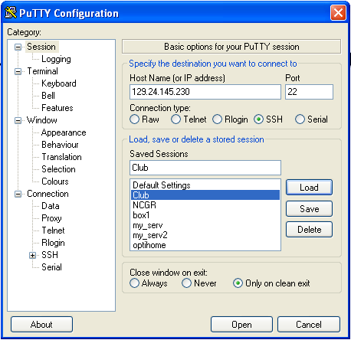
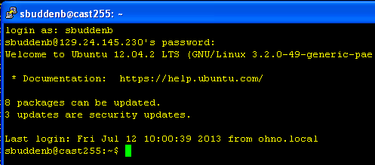
Connect to the server
Putty for Windows: download putty.exe
IP address: 129.24.145.230
Password: test
1
Mac:
Call out terminal window (Command key + T)
OR Navigate to /Applications/Utilities => Terminal.
type command: ssh sbuddenb@129.24.145.230
2

Slide 5
UNIX Tutorial for Beginners
http://www.ee.surrey.ac.uk/Teaching/Unix/

Slide 6
Commands practice
Folder of test data and commands:
/media/LB/testdata
Follow the practice_commands.txt
Download from FTP address
Access data and process the data
Example of calling other programs
Reads assembly program: abyss
Example of Perl Script
Automatic workflows

Slide 7
NGS Tools
  http://seqanswers.com/forums/showthread.php?t=43
Visit UNM Bioinformatics Discussion Group
  http://discoveryandinnovation.com/UNM_bioinformatics/discussion.html

