Slide 1
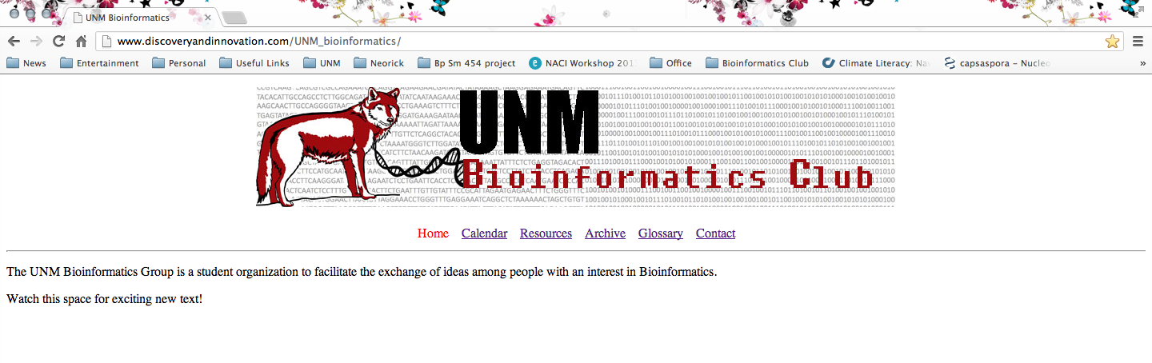
http://www.discoveryandinnovation.com/UNM_bioinformatics/
THANKS PAUL!

Slide 2
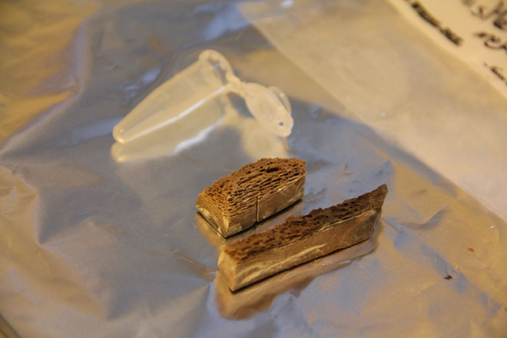
Latest News in Genomics
1.12x coverage draft genome of 560-780k yr old horse
Equus lineage gave rise to all contemporary horses, zebras, and donkeys 4-5 million years ago
Evidence for selection on the immune system
29 genomic regions corresponding to loci selected early during domestication
Helicos HeliScope
Illumina GAIIx

Slide 3
Latest News in Genomics
Human genes cannot be patented, but cDNA can be claimed as intellectual property
According to researchers at Weill Cornell Medical College, patents now cover ~40% of the human genome
…but some still aren’t sure if they believe in molecular biology

Slide 4
High Throughput Sequencing
The Past, Present, and Future

Slide 5
The Road to NGS
1866 Mendel’s pea experiments
1944 Genes made of nucleic acid
1952 Electrophoresis
1953 DNA molecular structure
1972 Cloning
1977 Sanger Sequencing
1985 PCR, DNA fingerprinting
1990 BLAST
1995 Microarray technology
2001 Human genome

Slide 6
Past

Slide 7
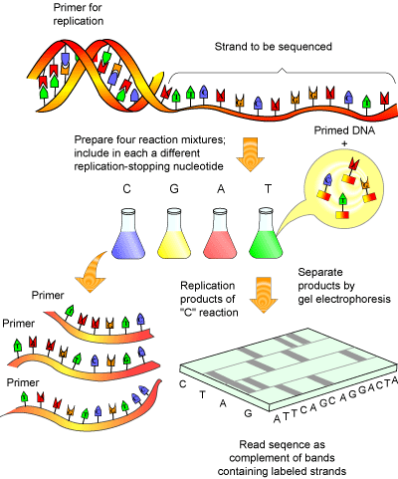
1977-mid 2000s Sanger Sequencing
Notes:
Great advances over 3 decades: fluorescent labelling, capillary electrophoresis, and general automation
DNA is amplified and denatured to produce ssDNA
Sequencing primer is annealed
Sequencing terminates when a dideoxynculeotide becomes incorporated
Fragments remain bound to the single stranded DNA molecule which has acted as a template
Heating and denaturing the partially double stranded molecules, will release them from their template
Separated using high resolution denaturing gel electrophoresis

Slide 8
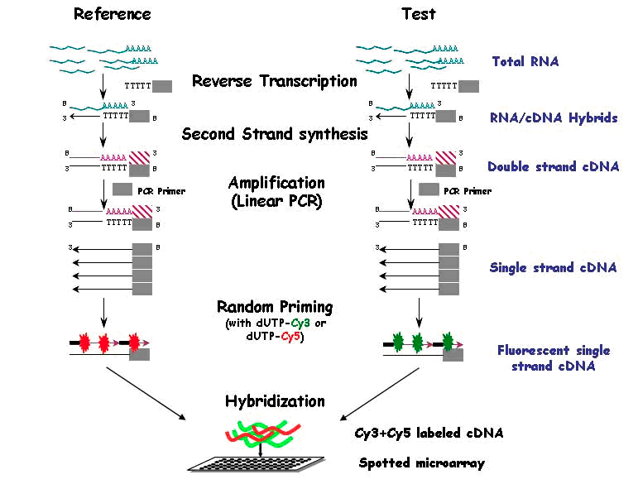
1995-current Microarray

Slide 9
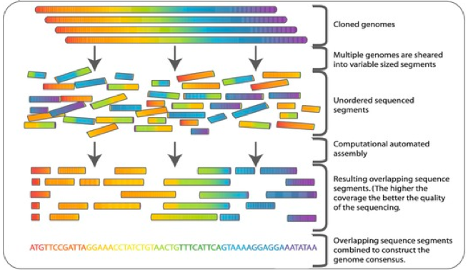
1995-2005 Classical Shotgun Sequencing
Notes:
High mol weight DNA sheared into random fragments and cloned into an appropriate vector
Clones are then sequenced from both ends using the chain termination method yielding two short sequences
The two reads from the same clone are referred to as mate pairs
Mate pairs will rarely overlap
Original sequence is reconstruction from the reads using sequence assembly software
Overlapping reads collected into longer composite contigs
Contigs linked together to form scaffolds
PCR followed by sequencing or vectors can be used to fill in gaps

Slide 10

2001 Human Genome Project

Slide 11
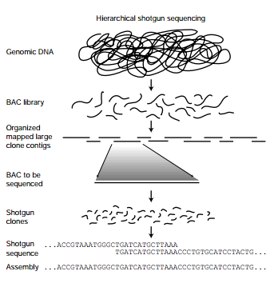
2001 Human Genome Project
Notes:
Library construction by fragmenting target genome and cloning it into large-fragment cloning vector (BAC vectors shown)
Random shotgun sequencing of BAC clones
Clone sequences assembled to reconstruct the sequence of the genome

Slide 12
One Decade
~3 gigabases/13 yrs → 3 gigabases/day
Human genome project $1000 human genome
$3 billion

Slide 13
Present

Slide 14






Platforms
SOLiD

Slide 15
454 Pyrosequencing
Whole Genome Sequencing
  Shotgun
  Paired End
Metagenomics
  18S and 16S rRNA Amplicon Seueqnecing
  Shotgun metagenomics
  cDNA metagenomics- pathogen detection
Transcriptome
  cDNA rapid library prep
  Low-input RNA samples (500pg)

Slide 16
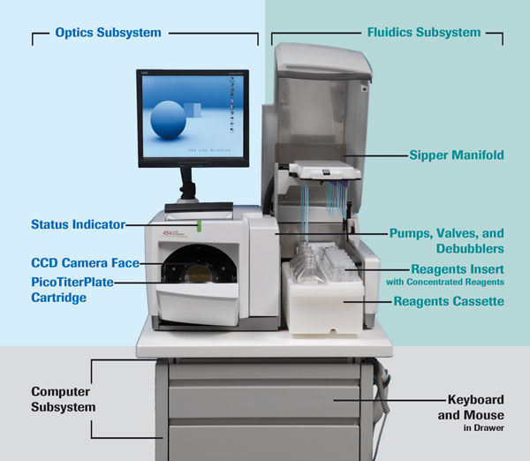
454

Slide 17
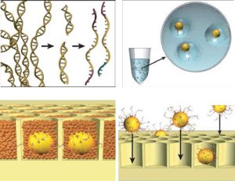
454
Notes:
De novo shotgun
Paired end

Slide 18
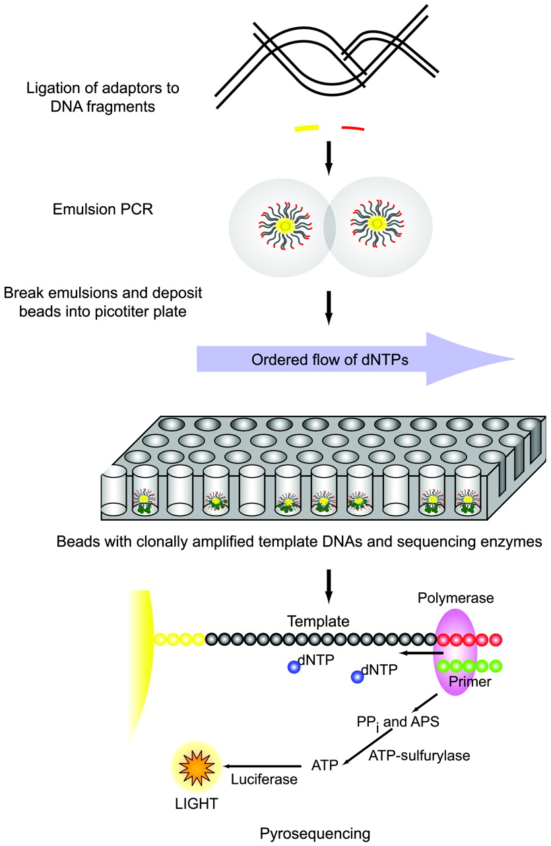
454
Notes:
DNA fragmented and then ssDNA
DNA bound to beads and DNA copied millions of times
Beads put in wells on a fiber optic slide
Nucleotides flow over wells and begin building second strand of DNA
When a nucleotide is incorporated a pyrophosphate is released which is converted to ATP
ATP fuels a bioluminescent luciferase enzyme to produce lights
Camera captures the light and the number of nucleotides incorporated can be estimated from the brightness

Slide 19
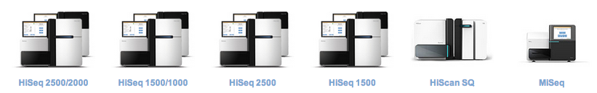
Illumina
DNA sequencing
RNA sequencing
Epigenetic sequencing

Slide 20
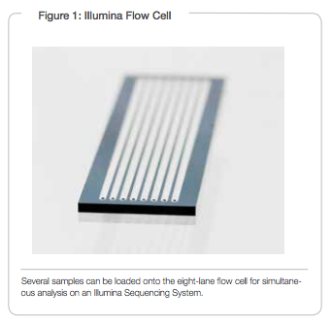
Illumina
Sequencing by Synthesis (SBS)
  A single fluorescently-labeled dNTP is added to the nucleic acid chain
  This serves as a terminator for polymerization so the dye is imaged and signal intensity is measured to identify the base and finally cleaved to allow incorporation of the next nucleotide

Slide 21
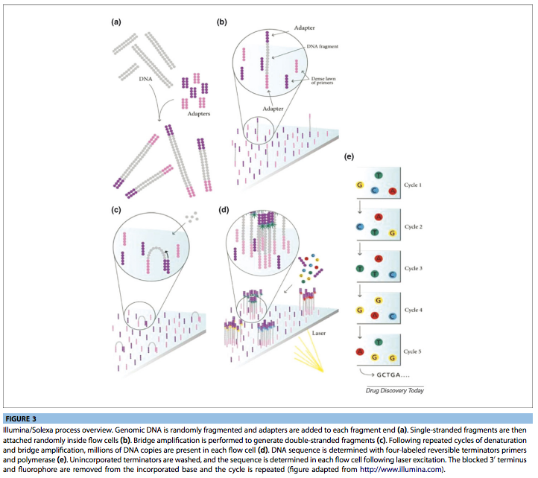
Illumina

Slide 22
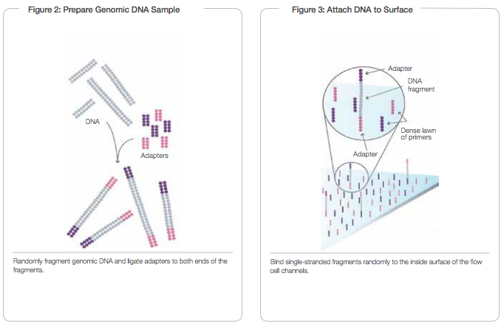
Illumina

Slide 23
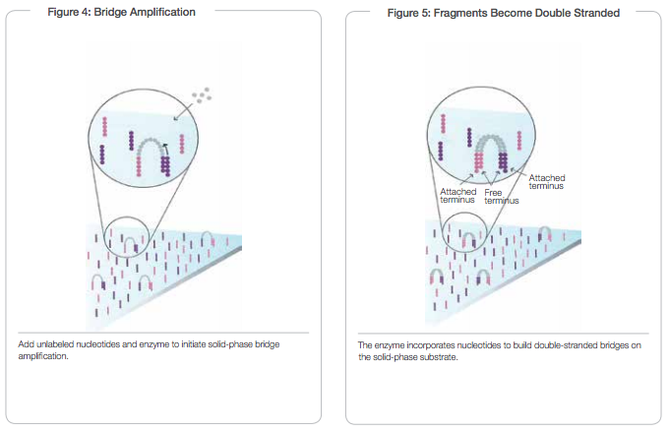
Illumina

Slide 24
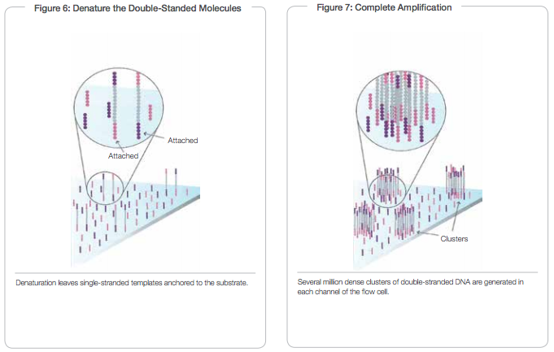
Illumina

Slide 25
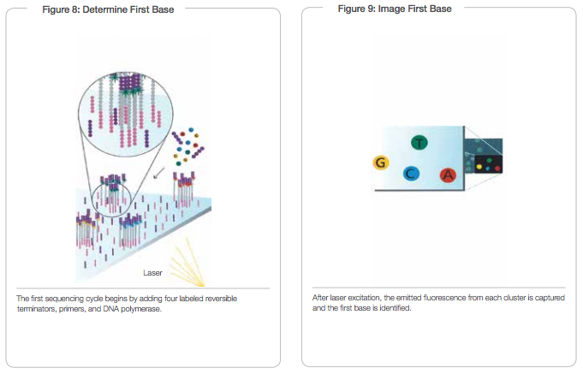
Illumina

Slide 26
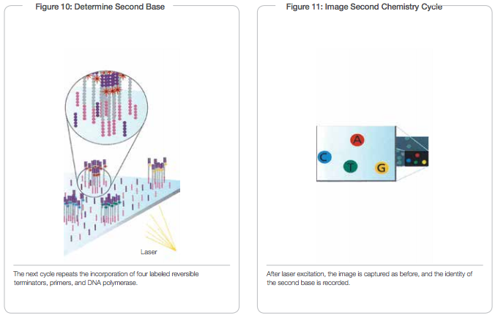
Illumina

Slide 27
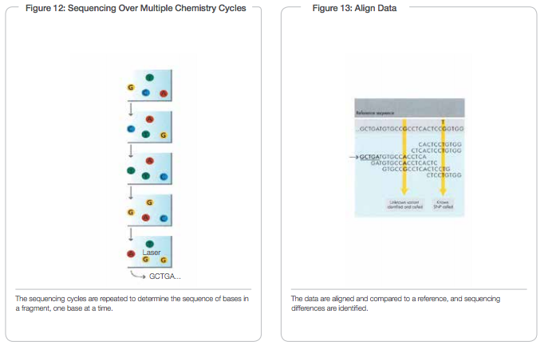
Illumina

Slide 28
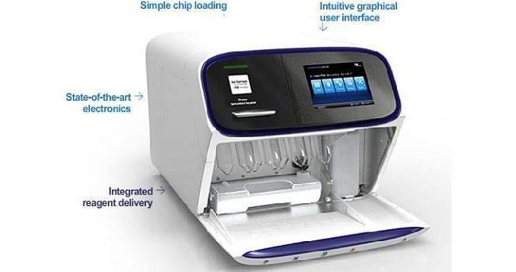
Ion Torrent
Ion Torrent video
Evolution of Ion Torrent to $1000 human genome

Slide 29
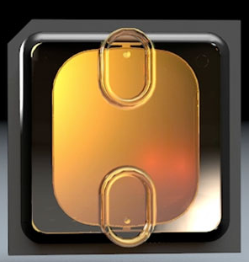
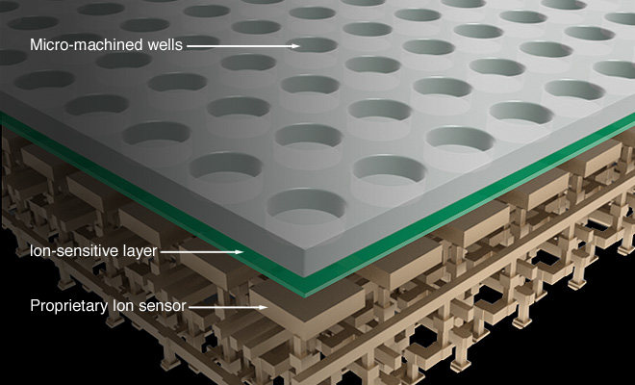
Ion Torrent
660 million wells on Chip II

Slide 30
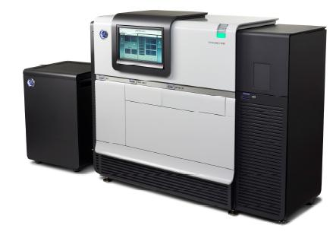
Pac Bio: Single Molecule, Real-Time (SMRT)
De Novo assembly
Targeted sequencing of genetic variations (structural, haplotypes, and rare SNPs)
Base modification identification (detect genetic regulation and DNA damage)
Eavesdropping on a single
DNA polymerase

Slide 31
SOLiD: Sequencing by Oligonucleotide Ligation and Detection
Library Preparation
  Fragment or mate-paired
Template Preparation
  Template + PCR reaction components + beads + primers
Bead Deposition
  Deposit beads onto glass slide or FlowChip(s)
Sequencing by Ligation
  Primers hybridize to adapter sequence on template beads
  Fluorescently labeled dNTP probes compete for ligation to primer
Primer Reset
  Every base interrogated in two independent ligation reactions by two primers
Exact Call Chemistry
  Sequencing with additional primer to increase accuracy

Slide 32
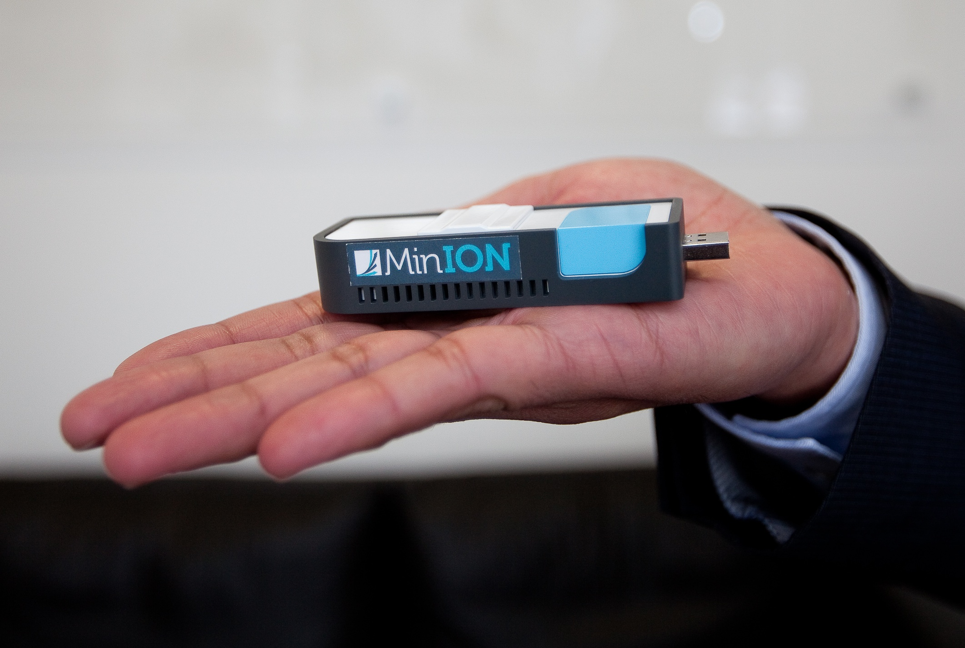
Nanopore
“Strand sequencing”; both strands sequenced
Real-time base calling
Each base read 3 times
GridION and MinION
Notes:
danfelker@gmail.com
Unix

Slide 33
 | List Price | Reagent costs/run | Reagent costs/Mb | Error rates (%) | Run Time | Millions of Reads/run | Bases/read | MB/run
3730xl (capillary) | $376k | $144 | $2,308 | 0.1-1 | 2 hrs | 9.6x10-5 | 650 | 0.06
454 GS Jr. | $108k | $1,100 | $22 | 1 | 10 hrs | 0.1 | 400 | 50
454 FLX Ti | $450k | $6,200 | $12 | 1 | 10 hrs | 1 | 400 | 400
PacBio RS | $695k | $~300 | $2-17 | <1 | <2 hrs | 0.03 | >3,000 | 100-150
Ion Torrent | $49k | $539-939 | $5-0.60 | ~1 | 4-7 hrs | 0.1-4 | 400 | 40-1,500
Ion Torrent Proton I | $224k | $1,050 | $0.09 | ~1 | <4 hrs | 70 | <200 | 10,000
SOLiD | $251k | $10,503 | $0.07 | <0.1 | 8 days | >1,410 | 75+35 | 155,100
MiSeq v2 | $125k | $1,040 | $0.70 | ~0.1 | 39 hrs | 15 | 250+250 | 7,500
GAIIx | $250k | $17,575 | $0.19 | ~0.1 | 14 days | 300 | 150+150 | 96,000
HiSeq 1000 | $560k | $10,220 | $0.04 | ~0.1 | 8.5 days | <1,500 | 100+100 | <300,000
HiSeq 2000 | $690k | $23,470 | $0.04 | ~0.1 | 11.5 days | <3,000 | 100+100 | <600,000
HiSeq 2500 | $690k | $6,145 | $0.05 | ~0.1 | 40 hrs | <600 | 150+150 | <180,000

Slide 34
 | BACs,plastids, and microbial genomes | Transcriptome | Plant/Animal genomes
454 GS Jr. | Good; expensive | Need many runs; expensive | Way too expensive
454 FLX+ | Good; should multiplex | Good; expensive | Not for use alone
MiSeq | Good; should multiplex | Expensive; reads longer | Expensive; reads longer
HiSeq 2000/2500 std | More data than needed; assembly challenge | Good; assembly challenge; more data | Primary platform used
Ion Torrent 314 | Reads shorter and more $ than Illumina | Reads shorter and more $ than Illumina | Way too expensive
Ion Torrent 318 | Less data than MiSeq | Reads similar to 454 but less expensive | Less $ than 454, more than Proton or Illumina
Ion Torrent Proton I | More data than needed; assembly challenge | Assembly even more challenging than Illumina | Expensive compared to HiSeq or Proton II/III
SOLiD | More data than needed; assembly challenge | Super short reads make assembly verge near impossible | Super short reads make assembly verge near impossible
PacBio - RS | Good for hybrid assemblies | Good for hybrid assemblies | Good for hybrid assemblies and mixed platform strategy

Slide 35
 | Metagenomics | Mutation Detection | Comments
454 GS Jr. | Costs limit sample # and depth | Way too expensive
454 FLX+ | Good but expensive | Expensive; good for identifying clusters | Reliability issues
MiSeq | Good; shorter reads than 454 but more depth | More expensive than HiSeq, SOLiD or Proton II | Kits are expensive
HiSeq 2000/2500 std | Good; short reads | Common platform used
Ion Torrent 314 | Reads shorter and more $ than Illumina | Reads shorter and more $ than Illumina
Ion Torrent 318 | Commonly replacing 454 | More $ than MiSeq, HiSeq, SOLid, Proton | $ increasing with increased read length
Ion Torrent Proton I | Shorter reads than 454 or MiSeq; longer than HiSeq | More $ than HiSeq or SOLid
SOLiD | Reads too short | Common platform used | Being replaced by better technology
PacBio - RS | Expensive but long reads good for hybrid sequencing | Way too expensive; insufficient accuracy | Not evolving as quickly as other platforms

Slide 36
Future

Slide 37
 | List Price | Reagent costs/run | Reagent costs/Mb | Error rates (%) | Run Time | Millions of Reads/run | Bases/read | MB/run
HiSeq 2500 rapid run | $690k? My guess | 6,145 | 0.05 | ~0.1 | 40 hrs | <600 | 150+ 150 | <180,000
Ion Torrent Proton II | $224k | 1,000 | 0.02 | 1 | >4 hrs | 250 | <200 | 50,000
Ion Torrent Proton III | $224k | 1,000 | 0.01 | 1 | >4 hrs | 500 | <200 | 100,000
minION | $0 | <900 | 1 | 4 | <6 hrs | 0.1 | 9,000 | 1,000
GridION | 30? | Varies | 0.04 | 4 | ? | 5 | 10,000 | 100,000

Slide 38
 | BACs,plastids, and microbial genomes | Transcriptome | Plant/Animal genomes
HiSeq 2500 rapid run | More data than need; assembly challenge | Good; lots of data; assembly challenge | More $ than HiSeq2000 but inc. read length
Ion Torrent Proton II | More data than needed; assembly challenge | Assembly worse than Illumina | Similar to HiSeq
Ion Torrent Proton III | More data than needed | Need assembly pipelines | Best based on $/MB
minION | More expensive than GridION | More expensive than GridION | More expensive than GridION
GridION | High error rate; great for combining platforms | High error rate; great for combining platforms | High error rate; great for combining platforms

Slide 39
 | Metagenomics | Mutation Detection | Comments
HiSeq 2500 rapid run | Good but limited by short reads | Common platform | Unknown reagents costs
Ion Torrent Proton II | Longer reads than HiSeq | Similar cost to HiSeq and SOLiD | >400 bp reads!
Ion Torrent Proton III | Longer reads than HiSeq | Projected to be cost leader | >400 bp reads!
minION | Good for env samples, FIELD PORTABLE! but limited by accuracy | Accuracy limiting factor | Unknown availability date
GridION | Good for env samples, limited by accuracy | Accuracy limiting factor | Unknown availability date; reagents $ unknown

Slide 40
Other Developments
Genapsys
  Electronic detection of thermal/pH changes from nucleotide addition
Genia Technologies
  Pairing biological nanopores with semiconductor detection
Lasergen
  Pyrosequencing
NabSys
  Single-molecules analysis revealing genomic location of sequencing probes
Noblegen
  Optical detection of ‘expanded’ DNA templates passing through synthetic pores
Qiagen Intelligent Bio-Systems
  Pyrosequencing
Stratos Genomics
  Optical sequencing of fluorescently labeled, synthetically expanded templates

Slide 41
References
Eisenstein, M. 2012. The Battle for Sequencing Supremacy. Nature Biotechnology, 30(11), 1023-1026.
Glenn, T.C. 2011. Field Guide to Next Generation DNA Sequencers. Molecular Ecology Resources. 11(5), 759-769.
Liu, L. et al. 2012. Comparison of Next-Generation Sequencing Systems. Journal of Biomedicine and Biotechnology, 2012, 1-11.
Orlando, L. et al. 2013. Recalibrating Equus Evolution Using the Genome of an Early Middle Pleistocene Horse. Nature Letters.
Quail, M.A., et al. 2012. A Tale of Three Next Generation Sequencing Platforms: comparison of Ion Torrent, Pacific Biosciences and Illumina MiSeq sequencers. BMC Genomics, 13(341), 1-13.
Voelkerdine, K.V., Dames, S.A., and Durtschi, J.D. 2009. Next-Generation Sequencing: From Basic Research to Diagnostic. Clinical Chemistry, 55(4), 641-658.
www.illumina.com
www.454.com
www.pacificbiosciences.com
www.iontorrent.com
www. Invitrogen.com

